Slide 1
Financial Modeling
Balance Sheets, Income Statements, Cash Flow Statements
Jacqueline Garner, Ph.D.
Lecturer
Scheller College of Business
Building Cash flow To
Equityholders

Slide 2
Before We Begin…
Notes:
In this lesson we will discuss and calculate CF to equityholders.

Slide 3
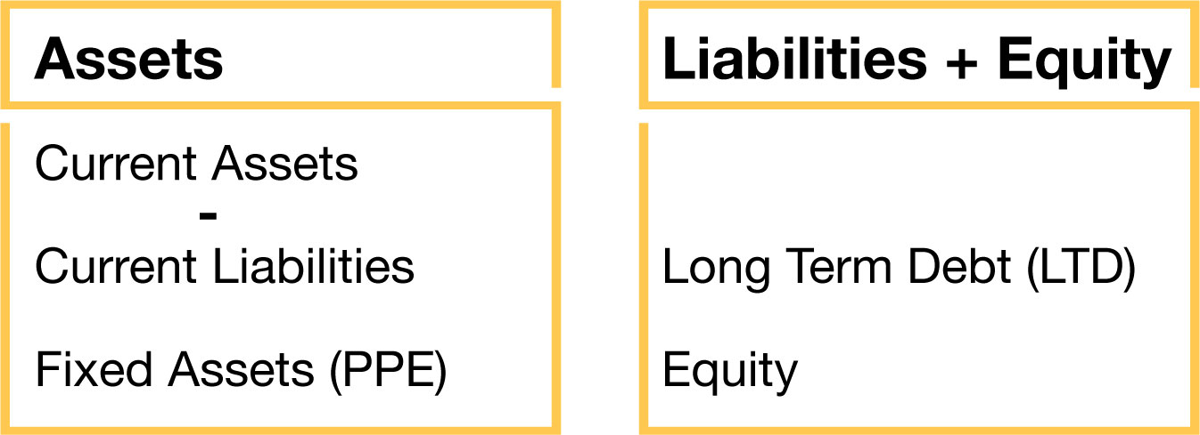
Balance Sheet with CL Netted Against CA
We are now interested in the CFs TO the equity/stock holders

Slide 4
Organization of Cash flow to Equityholders
Cash Flow TO Equityholders
Plus dividends (inflow)
Less net new equity (could be inflow or outflow)
Notes:
Note: Net new equity could be positive or negative. If it is positive, then that means equityholders bought new equity, so when we subtract that, it’s an outflow for them. If “net new equity” is negative, that means equity went down, perhaps from the firm repurchasing stock, and when we subtract a negative number, the equityholders receive an inflow.

Slide 5
Example of Cash flow TO Equityholders
Let’s look at an example:
Please download the file named
“Balance_Sheets_Income_Statements_Example.xlsx”

Slide 6
Summary
Notes:
In this lesson, we demonstrated how to calculated CF to equityholders (aka stockholders). Thank you!

